Slide 1
SUDOKU SOLVER
C-mini project -Aayush Acharya (074BCT501) -Bibek Kaliraj(074BCT510) SUBMITTED TO: DEPARTMENT OF ELECTRONICS And COMPUTER ENGINEERING

Slide 2
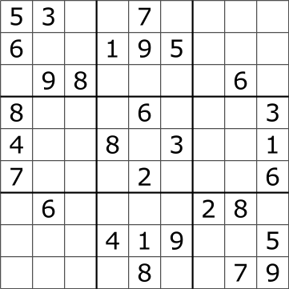
SUDOKU
Sudoku has a 9x9 grid divided into 9 3x3 grids.
Each cell has to be filled from numbers 1-9 such that a. Each row has different number. b. Each column has a different number. c. Each 3x3 box or grid has different number.

Slide 3
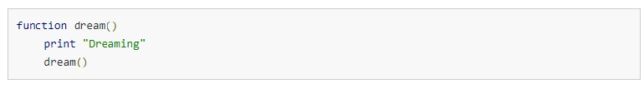
Recursion and backtracking
Recursion is when a function calls itself.
It is a very useful tool in solving problems of same kind.
A recursion must have terminating condition.
Those who have watched Inception can relate…
Notes:
Tell about stack overflow.

Slide 4
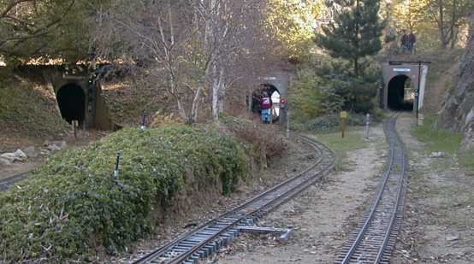
Continued..
Backtracking means to retrace one’s steps. ▪ It can be used by recursion or stack iteration.
It can be clearly understood by this ↓ example
Notes:
Gold and 3 tunnels

Slide 5
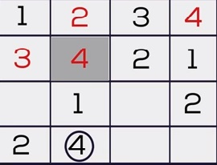
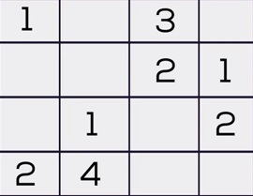
Solving Sudoku Using Backtracking
Let us consider a 4x4 Sudoku for argument’s sake.
First we check empty cells location in this 4x4 grid.
Then, we set a loop from 1-4, check whether there is conflict
If no conflict, assign it to matrix element and recursively fill the rest.
If for a particular cell no number from 1-4 are satisfied then backtrack and reassign value to previous cell
No number from 1-4 satisfies the condition in that cell.
An 4x4 Sudoku grid

Slide 6
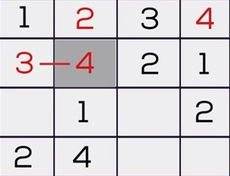
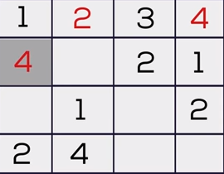
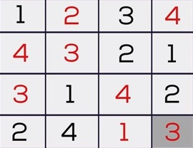
Since no condition satisfies it, we backtrack.
So we backtrack and number increases to 4
Similarly we fill the rest of the grid

Slide 7
Bbool solveSudoku(sudoku[9][9])
int row,col,num=1;
is any cell empty ?
N
return true;
Y
is (num<=9) ?
Is there any conflict?
Y
N
sudoku[row][col]=num
is (solveSudoku(sudoku)==true?
Y
return true;
N
sudoku[row][col]=EMPTY; num++
return false;
Fig: Flowchart

Slide 8
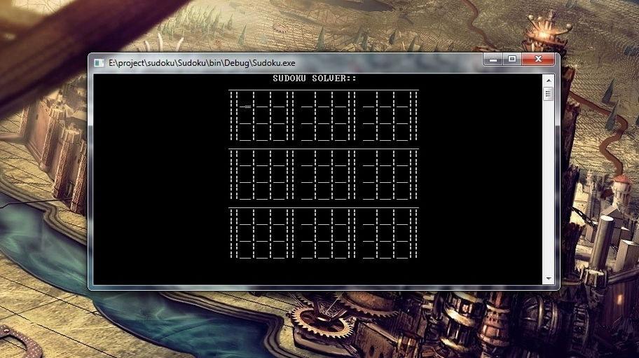
OUTPUT SNAPSHOTS

Slide 9
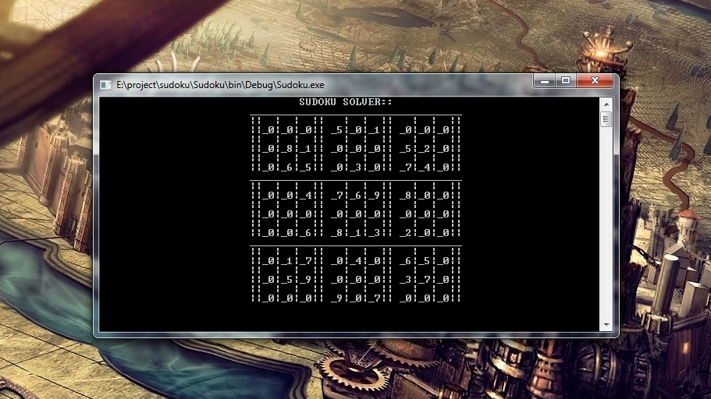
Filling the Sudoku Grid

Slide 10
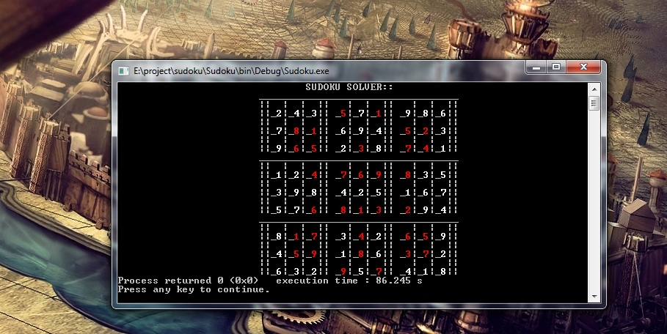
Solved Sudoku

Slide 11
Problems and future enhancements
Have to enter zero for every empty cell We plan to make a program where the user only has to enter certain cells.
Cursor change using only enter keys We plan to introduce arrow keys which would also solve the above problem.
Plan to make Sudoku game Not stored problems but randomly generated ones.
Improve the user interface It’s hard to top that but we’ll try.

Slide 12

ANY QUESTIONS ?

Slide 13


